Slide 1


Lyeen Tuscano
Lyeen Tuscano
Digital Marketing Campaign Conversion Prediction
In today’s competitive digital space, understanding which customers are likely to convert can transform how campaigns are designed and delivered. This project aims to use machine learning to uncover patterns in customer behavior — from demographics to engagement — and build a predictive model that helps marketers focus their efforts on the right audience. By doing so, we hope to drive smarter targeting, reduce wasted ad spend, and ultimately boost conversion rates.

Slide 2




Project Objectives
Identify Customer Demographics and Behavior Patterns
Examine the dataset to uncover trends in user behavior, such as which age groups or occupations are more likely to engage with the campaign.
Build a Predictive Model to Forecast Customer Conversions
Use supervised learning techniques to predict whether a customer will convert based on demographic and behavioral features.
Reduce advertising waste
Prevent inefficient ad spend by excluding users unlikely to convert based on data-driven insights

Slide 3
What’s in the Data?
Demographic Information
Marketing specific Variables
Customer Engagement Variables
Historical Data
Target Variable
CustomerID: Unique identifier for each customer.
Age: Age of the customer. Gender: Gender of the customer.
Income: Annual income of the customer in USD
CampaignChannel: The channel through which the marketing campaign is delivered
CampaignType: Type of the marketing campaign.
AdSpend: Amount spent on the marketing campaign in USD.
ClickThroughRate: Rate at which customers click on the marketing content.
ConversionRate: Rate at which clicks convert to desired actions.
WebsiteVisits: Number of visits to the website.
PagesPerVisit: Average number of pages visited per session.
TimeOnSite: Average time spent on the website per .
SocialShares: Number of times the marketing content was shared on social media.
EmailOpens: Number of times marketing emails were opened.
EmailClicks: Number of times links in marketing emails were clicked.
PreviousPurchases: Number of previous purchases made by the customer.
LoyaltyPoints: Number of loyalty points accumulated by the customer.
Conversion: Binary variable indicating whether the customer converted (1) or not (0).

Slide 4

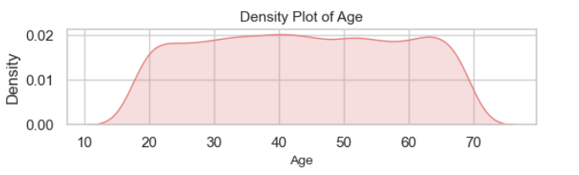
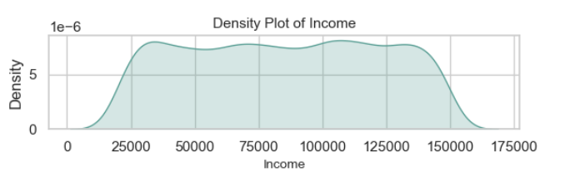
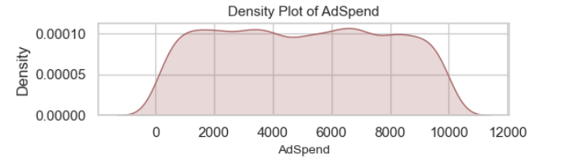
From Numbers to Narratives: EDA Insights
UNIVARIATE ANALYSIS
mean | 43.62
min | 18
25% | 31
50% | 43
75% | 56
max | 69
Numeric Data
Uniform distributions in demographic metrics like Age and Income suggest the campaign was possibly run in a broad or randomized fashion.
Flat distributions in AdSpend With the mean ≈ median (5000.94 ≈ 5013.44), the distribution is centered and symmetric.
mean | 84664.19
min | 20014
25% | 51744.5
50% | 84926.5
75% | 116815.75
max | 149986
mean | 5000.94
min | 100.05
25% | 2523.22
50% | 5013.44
75% | 7407.99
max | 9997.91

Slide 5
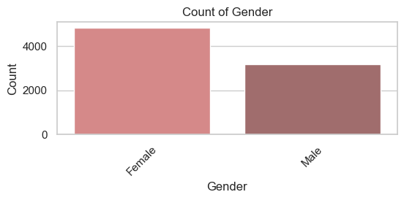
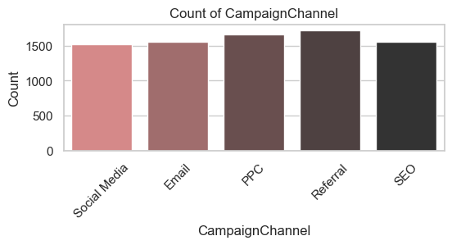
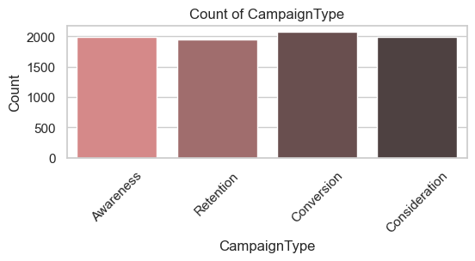
UNIVARIATE ANALYSIS
Categorical Data
Gender Distribution shows a higher representation of female users, suggesting that the campaign either resonates more with or targets female audiences more effectively.
The Campaign Channels and Campaign Types are evenly utilized, indicting a strategic focus across the entire marketing funnel.

Slide 6


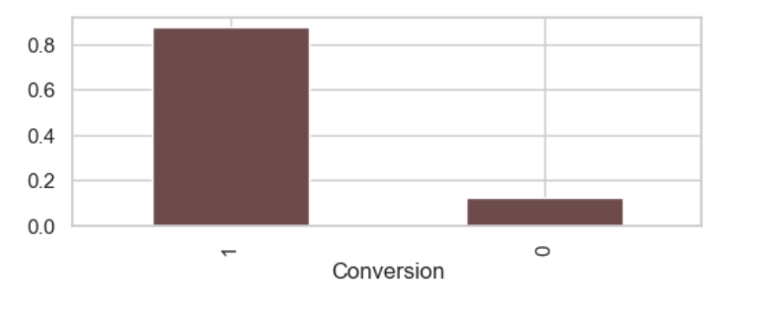
TARGET
Observation:
Converted (1): ~87% of total records
Not Converted (0): ~13% of total records
This shows a strong class imbalance
A model could get 87%+ accuracy by always predicting “1” but that would fail to identify non-converters
Hence, Our goal will be to focus on the minority class (non-converters)
.

Slide 7
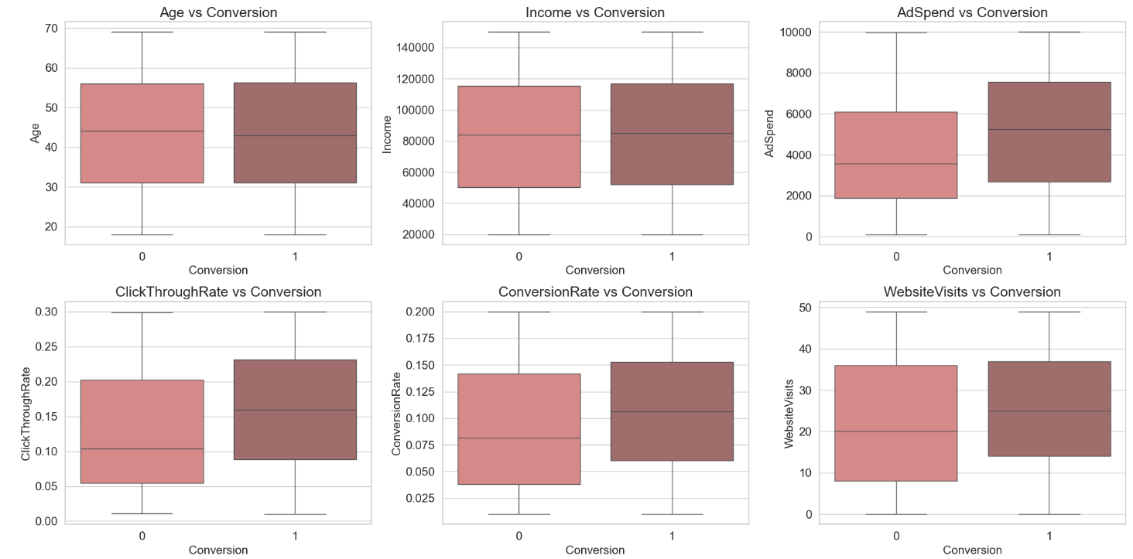
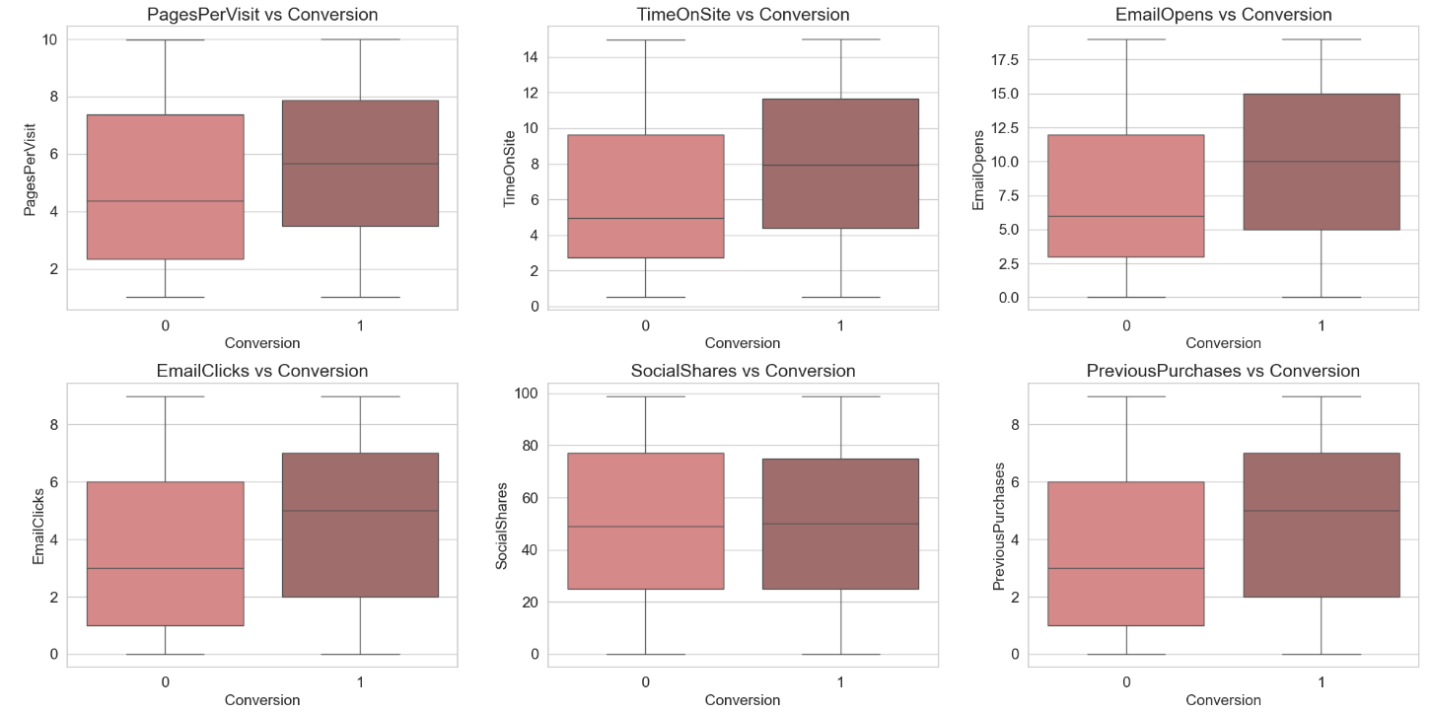

BI-VARIATE ANALYSIS
Numerical Data
Age and Income
The interquartile ranges (IQRs) overlap quite a lot for age and Income suggesting no strong trend, Hence can say Age and income has very less Predictive power.
TimeOnSite
The entire distribution for converted users is shifted slightly higher and even Median TimeOnSite increases.This suggests that TimeOnSite has good predictive Power.

Slide 8
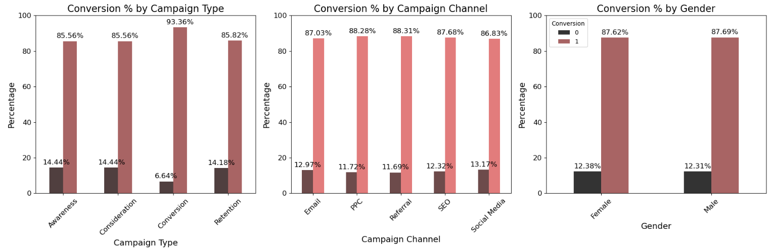
BI-VARIATE ANALYSIS
Categorical Data Analysis
The Conversion-type campaign performs best: 93.36% of people convert, and only 6.64% don’t.
Referral and PPC channels have the highest conversion rates (~88.3%).
Social Media has the lowest conversion among the channels: 86.83%, with the highest non-conversion rate (13.17%).
Both genders have ~12.3% non-conversion, ~87.6% conversion.

Slide 9
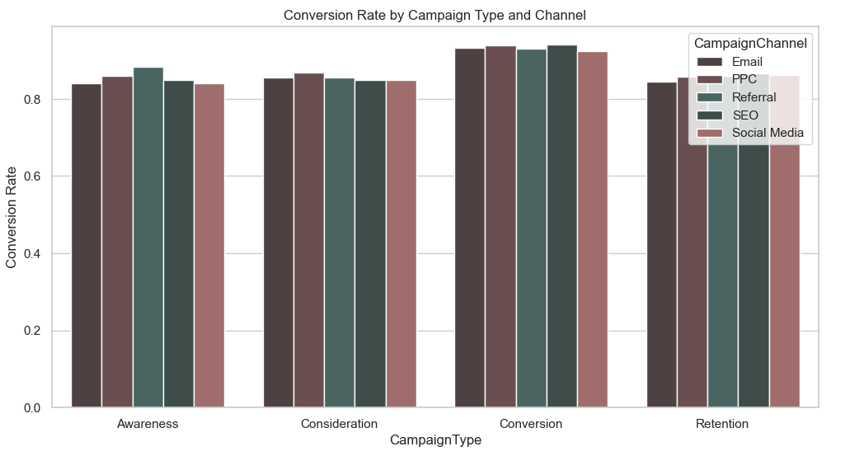
Key Takeaways:
Referral works best for Awareness.
PPC is consistently among the top across all campaign types.
Conversion campaigns perform best overall, across all channels (with conversion rates > 0.9).
Retention campaigns have relatively lower conversion rates (~0.84), regardless of channel.
MULTIVARIATE ANALYSIS

Slide 10

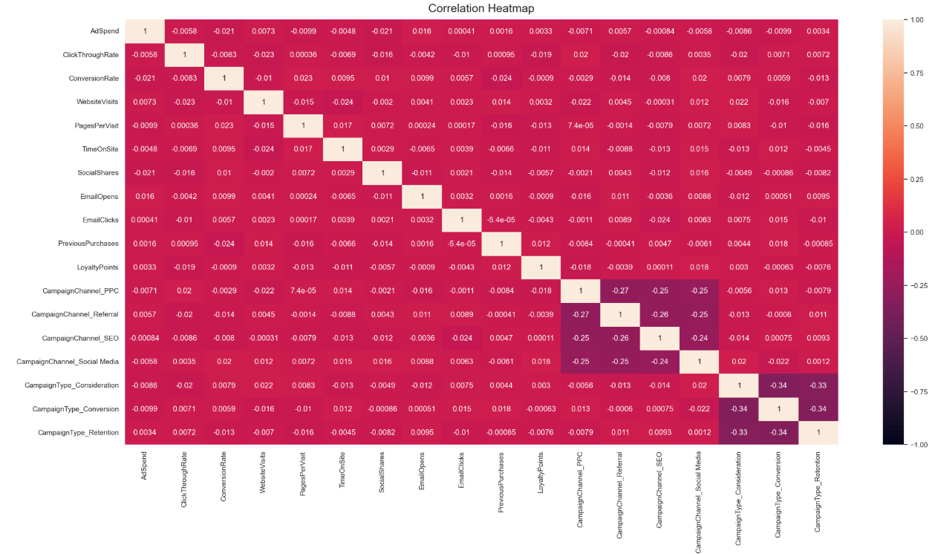
Correlation Analysis

Slide 11







Crafting the Core
How Raw Data Became Model-Ready
Low Variance and Irrelevant Feature Removal
Dropped CustomerID, AdvertisingPlatform, and AdvertisingTool due to constant values. Also removed Gender, Age, and Income based on minimal variance identified during EDA.
Missing Value Handling
No missing values detected in the dataset.
Outlier detection and Elimination
While EDA showed no prominent outliers, a precautionary approach was taken by applying EllipticEnvelope, and the top 0.005% of potential outliers were removed to ensure model robustness and stability.
Categorical Feature Encoding
Applied ‘get_dummies()’ to convert nominal features like CampaignType and CampaignChannel into binary indicators, enabling the model to interpret categorical data
Train Test Split
Splitting the data into training (80%) and testing (20%) sets.
Feature Scaling
To ensure that all numerical features contribute equally to the model and to improve its performance, applied StandardScaler.

Slide 12


The Brains Behind the Predictions
Decision
Tree
Random Forest
To find the most effective model for predicting non-converters, we tested 7 different algorithms:
Linear Models: Logistic Regression, SVM
Tree-Based Models: Decision Tree, Random Forest, XGBoost, LightGBM, AdaBoost
Each model will be evaluated using:
Precision, Recall, and F1 Score to focus on identifying non-converters in our imbalanced dataset.
Logistic Regression
ADBoost
XGBoost
LightGBM
SVM

Slide 13

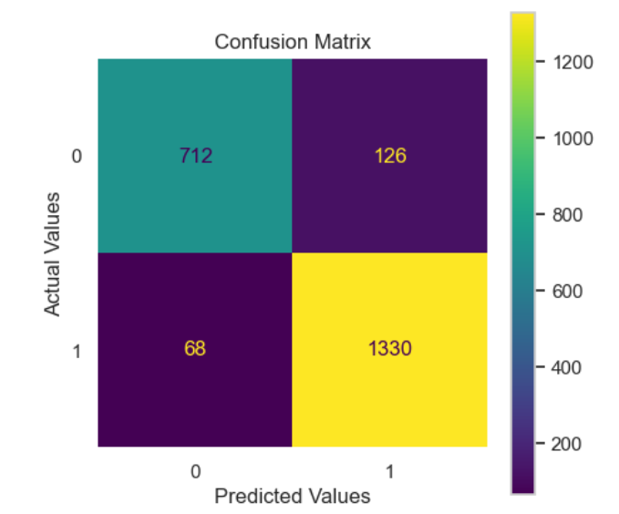
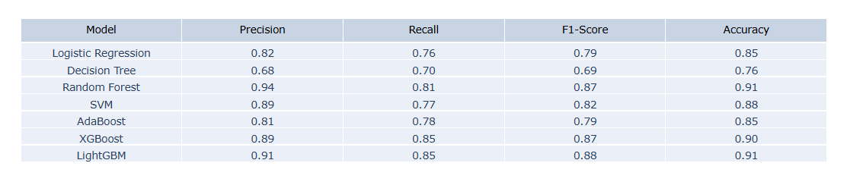
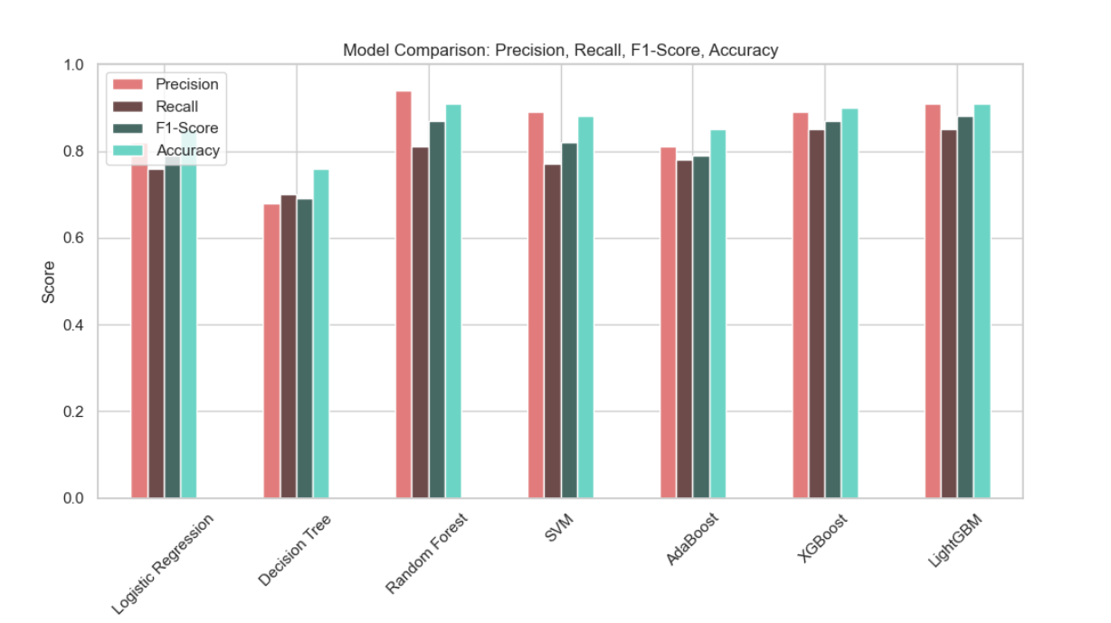
Battle of the Models: A Data-Driven Faceoff
From both the table and bar graph,
we observe that:
LightGBM, XGBoost, and Random Forest consistently perform well across all four metrics.
LightGBM stands out with the highest Recall (0.85) and F1-Score (0.88)—the two metrics most critical to this task.
While models like SVM and Random Forest show strong Precision, their Recall is slightly lower compared to LightGBM.

Slide 14
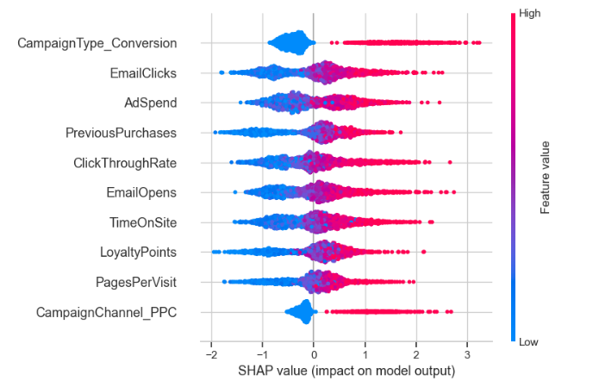
The Ingredients of Impact
Feature Impact: The plot shows which features have the biggest impact on predicting whether a user converts or not — ranked from most to least important.
Direction of Influence: Dots on the right (positive SHAP values) push the prediction toward conversion, while dots on the left push toward non-conversion.
Color Meaning: Each dot represents a user — red means high feature value, blue means low feature value (e.g., high AdSpend or low EmailClicks).
Key Insight: Features like CampaignType_Conversion, EmailClicks, and AdSpend have the strongest positive influence on conversion, while low values in those features often indicate non-conversion.

Slide 15

Model Locked, Goals Unlocked
Model Performance
LightGBM was selected as the best model based on its high Recall (0.85) and F1-score (0.88) for non-converters.
It effectively identifies users who are unlikely to convert, making it ideal for targeting strategies.
Key Takeaways:
The Overall analysis offers clear direction on why certain users do not convert, revealing opportunities to strengthen marketing and engagement strategies:
Low Engagement
Non-converters consistently show minimal interaction — low email opens, few clicks, and short site visits — indicating weak interest or poor content relevance.
Limited Purchase History
These users have little to no prior purchase activity or loyalty involvement, suggesting they haven't yet been nurtured into the customer journey.
Reduced Campaign Exposure
Many are not part of conversion-focused campaigns or PPC channels, showing potential gaps in targeting and segmentation.

Slide 16
Questions, If Any?

Slide 17



